Slide 1

NewsDetector presentation
Mohammd saleh alharbi

Slide 2
Agenda
Show
The results of domain understanding
Show
Demo
Show
infographic poster

Slide 3


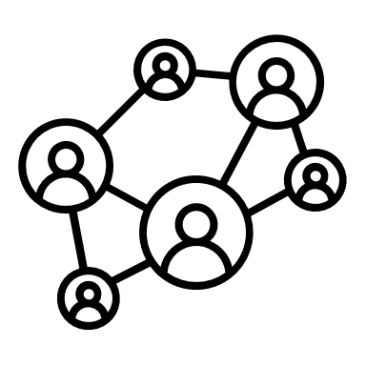
News approaches

Slide 4
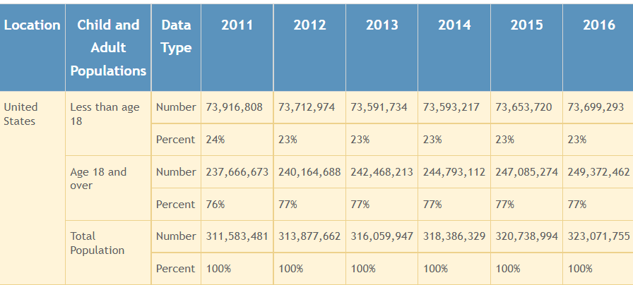
Example booming social media

Slide 5




Advantages of social media news

Slide 6

Disadvantages
Appearance of fake news
Political and personal gain

Slide 7


Definition
Fake news is a news article that is intentionally written and verifiably false.

Slide 8

Characteristics
Verifiably false
Mock real news structure with real evidence

Slide 9
Psychological point of view Fake news
1. Naïve realism
2. Confirmation

Slide 10
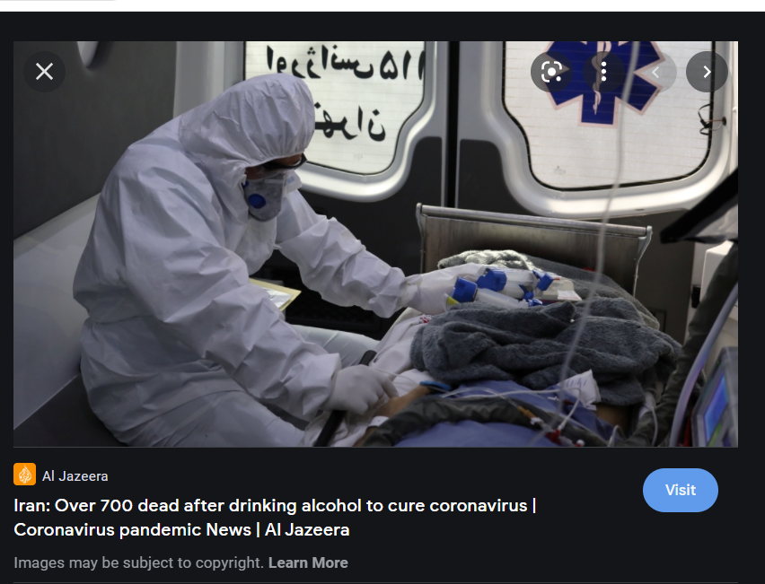
Fake news with covid 19 topic

Slide 11


Example of social impact after deploying the technology

Slide 12

Demo

Slide 13
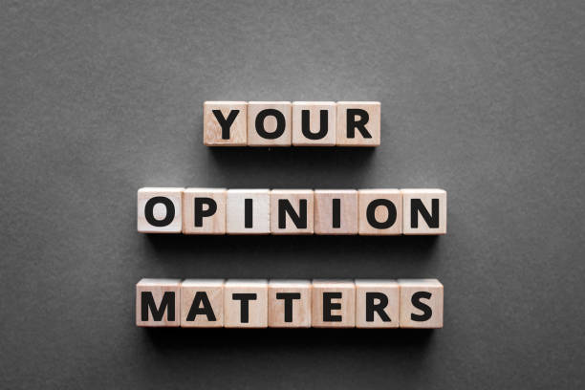
Get feedback

